Slide 1
What are you good at?

Slide 2
Can you ever call someone ‘gifted’ or ‘talented’?

Slide 3
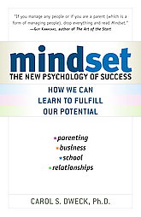
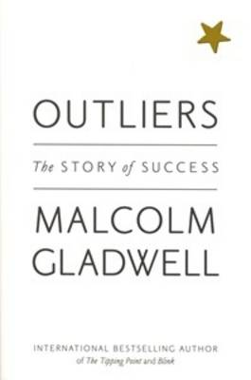
Shifting Mindsets

Slide 4
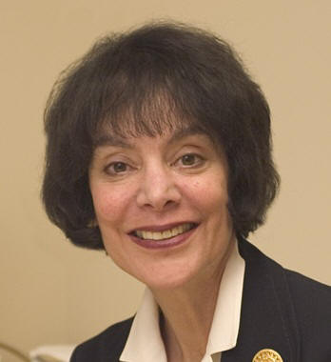
‘As teachers, we are entrusted with people’s lives. They are our responsibility and our legacy’
Carol Dweck

Slide 5


Slide 6
In brief…
Dweck suggests shifting how we view ability
She suggests moving away from seeing ability as something natural or innate
Suggests it is harmful to label children as ‘bright’, ‘clever’, ‘genius’ etc
By not emphasising effort, Dweck says this leads students to avoid challenge or situations where their ‘ability’ could be questioned.
She says that what matters in achieving our goals is not just ability but rather what mindset we adopt.

Slide 7
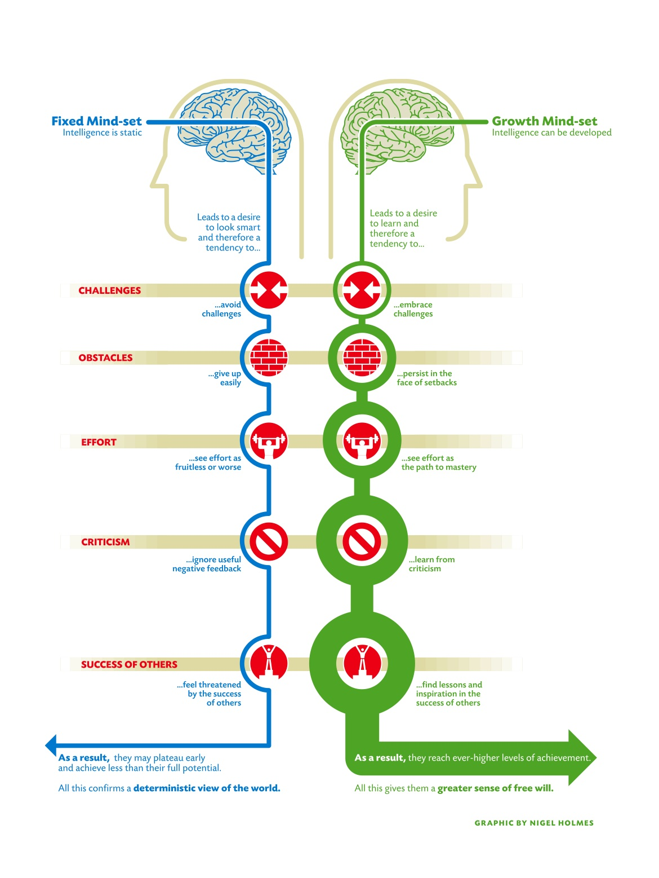
Fixed Mindset people tend to:
Avoid challenges
Give up easily
See effort as fruitless or a sign of weakness/lack of talent
Respond negatively to or ignore criticism
Shatter when they fail or face set back
Growth Mindset people tend to :
Embrace challenges
Have greater perseverance
See effort as the path to success
Learn from criticism
Be resilient to failure and setback

Slide 8
Growth Mindset is for life not just for school…..
Implications for school –
Students increasing effort they put into work.
Students start to enjoy the challenge and process of learning rather than just see the grade as the only goal.
Students learn to cope with setbacks and feelings of being ‘less clever’ and stress.
Implications for life –
Students will understand the need for increased effort at university and beyond.
Students grow into adults who are willing to take risks and face challenges in their work and life.
Students become better at coping with feelings of failure, inadequacy and rejection in academia, careers and relationships.

Slide 9
Real student examples…
Year 13 girl
Had always been told she was a natural academic. Had always been praised for her high grades. One teacher had even told her it would be a crime if she did not get in to Oxford.
Oxford rejected her. She performed poorly in some AS and A2 modules. She blamed the Oxford admissions. She said she obviously suffered from exam phobia. She would fuss and get herself wound up over any exam or essay.
Year 7 boy
Had got into Owen’s via the exam. Had been top of his class at primary school. His teachers always told him he was bright and clever. His parents reinforced this praise whenever he got good marks.
At Owen’s he was placed in a teaching group with many students who had done equally well previously. He often shied away from putting his hand up, and would shun challenging tasks. He would dismiss feedback on how to improve his written work. He began to seem disengaged in class.

Slide 10
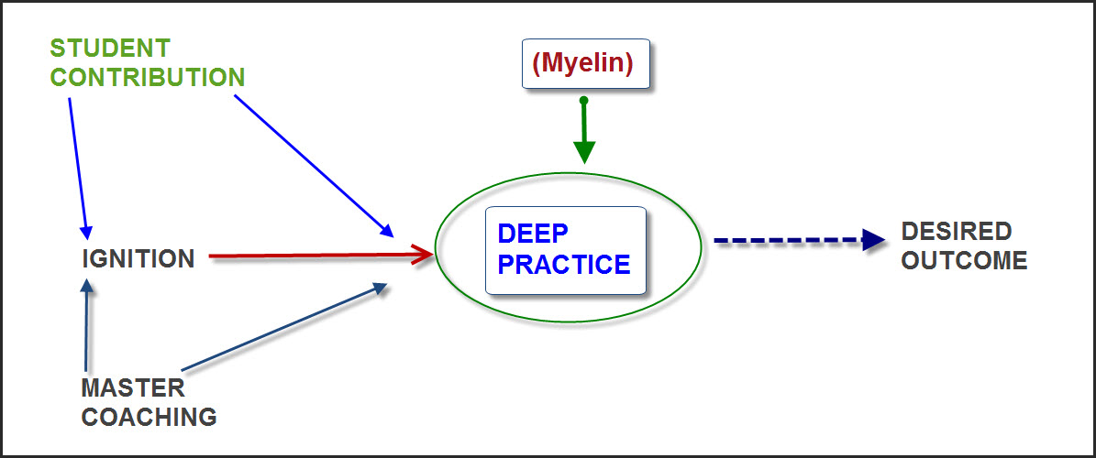

Daniel Coyle’s model of the learning process

Slide 11
The Classroom as a ‘Talent Hotbed’
Shared ethos and understanding of what learning is and how it works.
  Intelligence, ‘talent’ and aptitude is something that can be increased and developed through Deep Practice involving making mistakes and learning from them.
  Personal effort is what allows us to learn.
  Independence in learning is not only good, it is necessary – we are all responsible for our own learning and levels of effort.
The teacher to some extent can create the inspiration for the ‘ignition’ or capitalise on students’ ignited passion and then be a facilitator to their learning.
The classroom should provide as much opportunity for Deep Practice as possible.

Slide 12
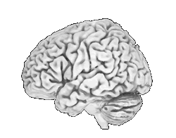



Slide 13
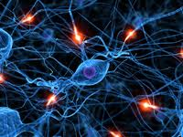

Slide 14
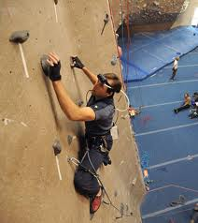

Slide 15
Practical Strategies for getting Growth Mindset into the Classroom

Slide 16
Fixed Mindset people tend to:
Avoid challenges
Give up easily
See effort as fruitless or a sign of weakness/lack of talent
Respond negatively to or ignore criticism
Shatter when they fail or face set back
Growth Mindset people tend to :
Embrace challenges
Have greater perseverance
See effort as the path to success
Learn from criticism
Be resilient to failure and setback

Slide 17
Practical Strategies for Growth Mindset in the Classroom

Slide 18
Being a ‘teacher-learner’
A model for having a growth mindset
Shifting the emphasis away from ‘ability’ or ‘talent’ and more to effort
YOU
Fallible
Encouraging failure
Language in the classroom and reports
Process of learning revealed – posters as well as method in teaching

Slide 19
Practical Ideas
Creating Stumbling Blocks
The Learning Passport
The Failure Classroom
The Thinking Classroom
The Learning Audit

Slide 20

Creating Stumbling Blocks
When the mind has to pause and stumble over some new information it learns it a little quicker.
This can be in information presented to students or students could do this for themselves when writing notes or revision tools.
Your notes/lesson materials could have information missing on purpose and the task for the students is to identify what is missing.
Similarly, include deliberate mistakes and the students need to discover what these are.
Students can use Exam Board Specifications, or templates, or another source to discover what is the stumbling block.

Slide 21
A
ocean/breeze
leaf/tree
sweet/sour
movie/actress
chair/couch
B
bread/b_tter
music/l_rics
sh_e/sock
phone/bo_k
l_nch/dinner

Slide 22


The Learning Passport
Formalises learning and providing strategies for how to be more independent.
Encourages higher level thinking by students engaging with extra materials in their subject area.
Forces students to be more independent and promotes self-sufficiency in their learning.
Provides a structure for their understanding of the subject.
Creates context for the other subject/topic material to fit in to, enabling quicker and more efficient teaching and learning of the course material at a higher level, because the understanding already has the context in which to be placed.

Slide 23
Using slightly difficult to read fonts can be more useful than just using standard ones.

Slide 24

The Failure Classroom
Talk about the fear of failure and how it may hold students back.
Ensure that your classroom fosters a supportive community spirit.
Encourage students to see failure as part of the learning process and celebrate it. You could use a mantra about failing or put up quotes about failure around the room.
Fast feedback from you and students. Get students to read/show/present answers or ideas and ensure criticism and suggestions are made as they go. By making mistakes and realising they are mistakes and correcting them, they learn quicker.
Model it through celebrities or other students on posters or in your delivery.

Slide 25
Examples of useful quotes on failure
‘The beginning of knowledge is the discovery of something we do not understand’.
Frank Herbert
‘When I was young, I observed that nine out of ten things I did were failures. So I did ten times more work.’
George Bernard Shaw
‘Try Again. Fail again. Fail better.’
Samuel Beckett

Slide 26
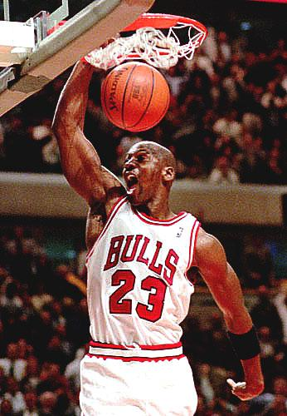
Celebrity example for reinforcing the idea of learning through failure
“I’ve missed more than 9,000 shots. I’ve lost almost 300 games. Twenty-six times, I’ve been trusted to take the game-winning shot, and missed.”
Michael Jordan

Slide 27

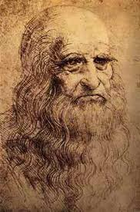
Debunking the ‘Talent Myth’ example posters
GENIUS*
NATURALS*
*
*
At the age of fourteen, Leonardo was apprenticed to the artist Andrea di Cione, known as Verrochio.
The workshop was "one of the finest in Florence” and many famous painters came from there.
Apprentices spent thousands of hours solving problems, trying and failing and trying again.
Whilst there he was exposed to huge amounts of theoretical training and a vast array of technical skills.
Florence was an epicentre for the rise of a powerful social invention called ‘craft guilds’.
As his fellow genius and resident of Florence, Michelangelo once commented:
“If people knew how hard I had to work to gain my mastery it would not seem so wonderful after all.”
They lived in a household full of books, magazines and toys.
In their early years they wrote continuously.
In fact, twenty-two little books averaging eighty pages in a fifteen-month period.
These were not original creations—they mimicked books and magazines of the time and were not very good.
By the time they had written their most famous books, they had spent many years practising writing.
‘Wuthering Heights’ came out in 1847 and reviewers marvelled at the natural storytelling of Emily Bronte.
However, all the ingredients of the story could be found in those tiny little books from her early years.

Slide 28
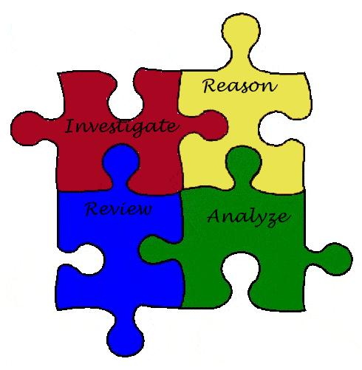
The Thinking Classroom
Aims to focus students on how to develop their learning through the skills involved.
Constant reference to what skills are involved is important to the ‘meta-learning’ aspect of lessons.
Skills can be used as the basis of particular lessons or referred to during activities. They could be outlined on posters or in a power-point which can be displayed when relevant.
Models the skills so that students can easily understand what they are.
Through understanding what skills are involved in higher order thinking and how they may be put into oral or written work, students can become more independent in their development as high achieving students.

Slide 29
Some examples of posters/slides for ‘The Thinking Classroom’

Slide 30

CLARITY AND PRECISION
Key skills
  Being exact, unambiguous, meticulous
What should you be doing?
  You make sensible contributions that are clear, precise and easily understood, you can recognise when there is a lack of clarity and that an idea should be clearer or further explained.
Things you are likely to say.
  “What I mean is…”
  “To put that in other words…”
  “What is an example of that?”
  “Can you say some more about that?”

Slide 31
ACCURACY
Key skills
  Seeking truth, plausibility, checking and double-checking, getting the facts, testing, proving
What should you be doing?
  Double check and proofread your work, look for evidence and fact, test claims, hypotheses and guesses before accepting them, look for inaccuracies and remove them
Things you are likely to say.
  “I know this is true because…”
  “I have checked and I’m sure…”
  “Is that true? How do you know?”
  “How can we test if this is accurate?”

Slide 32

FLEXIBILITY AND BREADTH
Key skills
  Broad-minded, open-minded, searching, original, new ideas, multiple perspectives
What should you be doing?
  You can see, consider and understand many different ideas on the same topic. Can come up with many different ideas and you are willing to change mind and reconsider ideas in face of legitimate criticism.
Things you are likely to say.
  “Another way of looking at this is…”
  “A different alternative is…”
  “Maybe…”
  “What is another way of looking at this…”
  “What if…”

Slide 33
DEPTH
Key skills
  Digging, detailed thinking, explaining, analysing, getting the whole picture, elaborating, exploring
What should you be doing?
  You can analyse, explore and explain complexities. Can draw distinctions and make connections, as well as categorising and classifying.
Things you are likely to say.
  “To give you more details…”
  “That links to…”
  “That is different from…”
  “Can you go into more depth?”
  “What are the implications of that?”

Slide 34

Learning Audit
Creates a system for evaluation of the learning process including critique and areas for development.
Enables students to see how their learning progresses and allows them to reflect on what they could do to further develop it.
This can be done in relation to the Course Specification and Assessment Objectives to ensure that both teacher and student feel it is not straying away from the ‘goal’ of the course.

Slide 35
Example 1
Lesson date | Topic/content covered | What did I learn? | What do I not understand? | Where can I find these answers? | What extra learning on the topic can I do?

Slide 36
Example 2
 | Date: | Date: | Date: | Date: | Date: | Date:
AO1
AO2
AO3
AO4
Outline of the key points of the assessment objectives and how you fulfil them in each lesson

